Slide 1
Drawing
Hosein Ghahremanzadeh
Notes:
The background is a sample of volumetric lighting in my own 3D graphics engine, HG3D

Slide 2
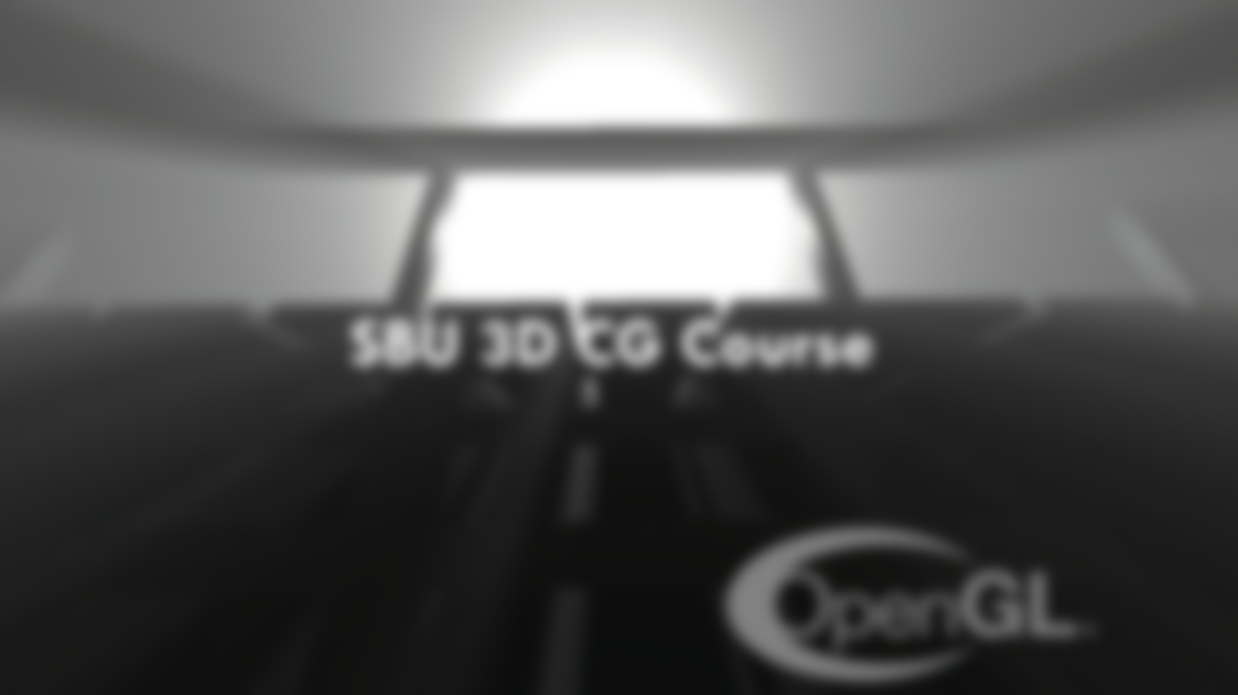
Drawing
Drawing needs a properly working pipeline.
Proper vertex data.
Proper framebuffer.

Slide 3
Working Pipeline
A working pipeline needs proper states:
Proper viewport.
Proper depth test.
Proper face culling test.
Proper program (vertex shader is necessary).

Slide 4
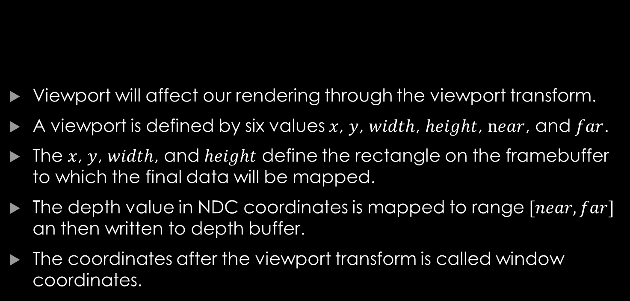
Viewport
Viewport will affect our rendering through the viewport transform.
A viewport is defined by six values $x$, $y$, $width$, $height$, $near$, and $far$.
The $x$, $y$, $width$, and $height$ define the rectangle on the framebuffer to which the final data will be mapped.
The depth value in NDC coordinates is mapped to range $[near, far]$ an then written to depth buffer.
The coordinates after the viewport transform is called window coordinates.
Notes:
The viewport defines the rectangle on the window, if drawing on window, on which the final image will be drawn. The origin being the left bottom of the window.
The $z$ values after the perspective divide, in NDC coordinates are in the range $[−1, 1]$, before writing this value to depth buffer, it is mapped to range $\left[near, far\right]$. This is the aforementioned viewport transform.

Slide 5
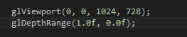
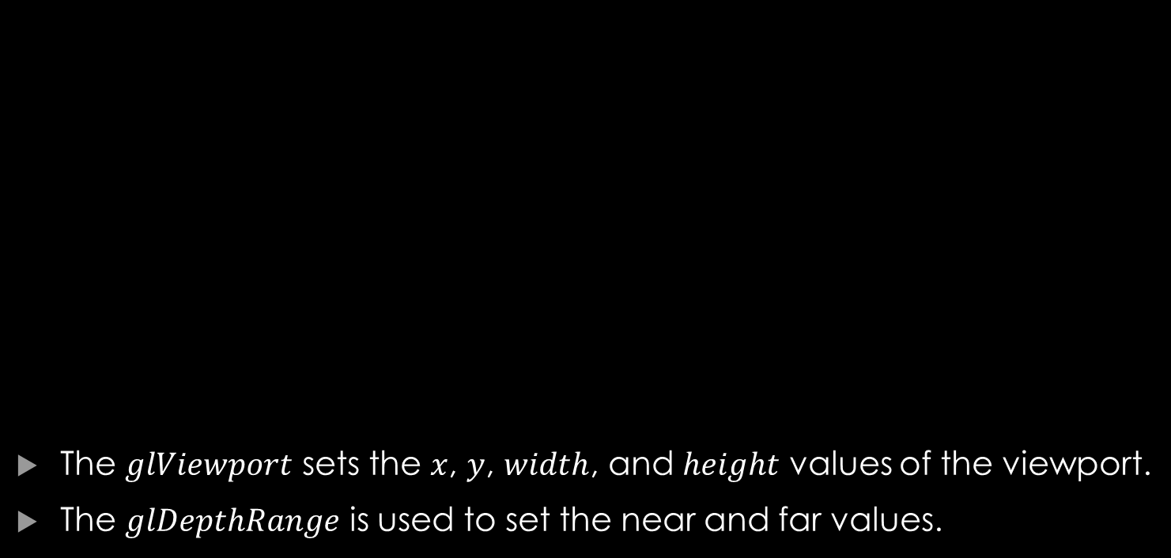
Viewport
The $glViewport$ sets the $x$, $y$, $width$, and $height$ values of the viewport.
The $glDepthRange$ is used to set the near and far values.
Notes:
The $glViewport$ gets $x$, $y$, $width$, and $height$ in this order.
The $glDepthRange$ function’s first parameter is the $near$ value and the second parameter is the $far$ value.
By default the $x$ and $y$ values are set to 0.
When an OpenGL context is connected to a windows the $width$ and $height$ values are set to the dimension of that windows.
The default values for $near$ and $far$ are 0 and 1.
The example sets the $x$ and $y$ value to 0, the $width$ and $height$ to 1024 and 728, and the $near$ to 1 and $far$ to 0.
As you see inverted mapping is valid as well, and in this example the $near$ is given greater value than $far$.

Slide 6
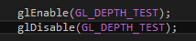
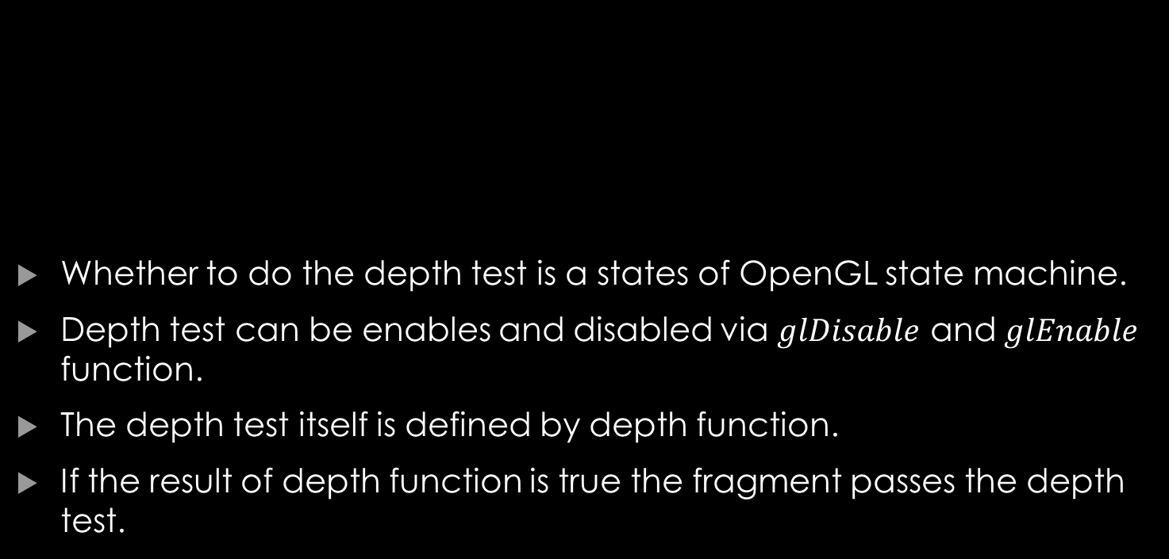
Depth Test
Whether to do the depth test is a states of OpenGL state machine.
Depth test can be enables and disabled via $glDisable$ and $glEnable$ function.
The depth test itself is defined by depth function.
If the result of depth function is true the fragment passes the depth test.

Slide 7
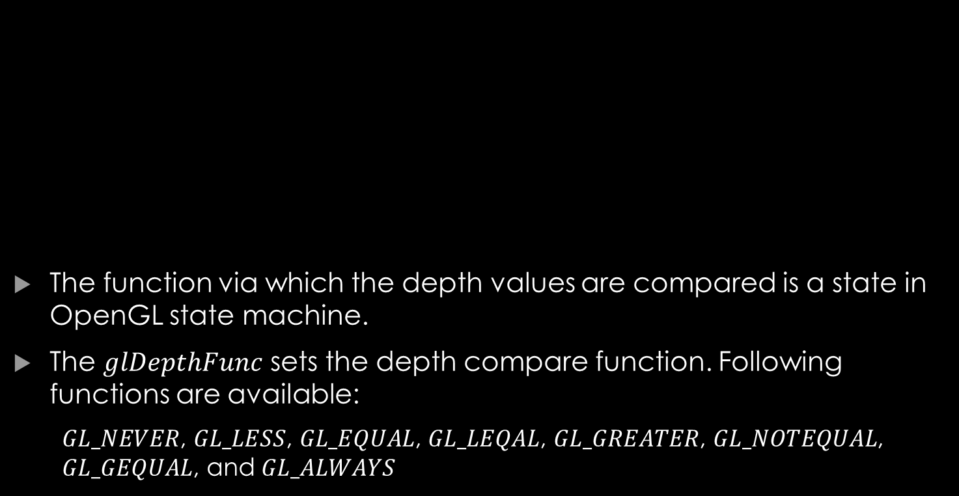
Depth Test
The function via which the depth values are compared is a state in OpenGL state machine.
The $glDepthFunc$ sets the depth compare function. Following functions are available:
$GL_NEVER$, $GL_LESS$, $GL_EQUAL$, $GL_LEQAL$, $GL_GREATER$, $GL_NOTEQUAL$, $GL_GEQUAL$, and $GL_ALWAYS$
Notes:
The $glDepthFunc$ receives the function flag as input, which can be on of the followings:
$GL_NEVER$: Fragment never passes the depth test.
$GL_LESS$: Fragment passes if its depth value is less than the corresponding value on the depth buffer.
$GL_EQUAL$: Fragment passes if its depth value is equal to the corresponding value on the depth buffer.
$GL_LEQAL$: Fragment passes if its depth value is less or equal to the corresponding value on the depth buffer.
$GL_GREATER$: Fragment passes if its depth value is greater than the corresponding value on the depth buffer.
$GL_NOTEQUAL$: Fragment passes the depth test if its depth test is not equal to the corresponding value on the depth buffer.
$GL_GEQUAL$: Fragment passes the depth test if its depth is greater or equal to the corresponding value on the depth buffer.
$GL_ALWAYS$: Fragment always passes the depth test.

Slide 8
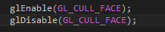
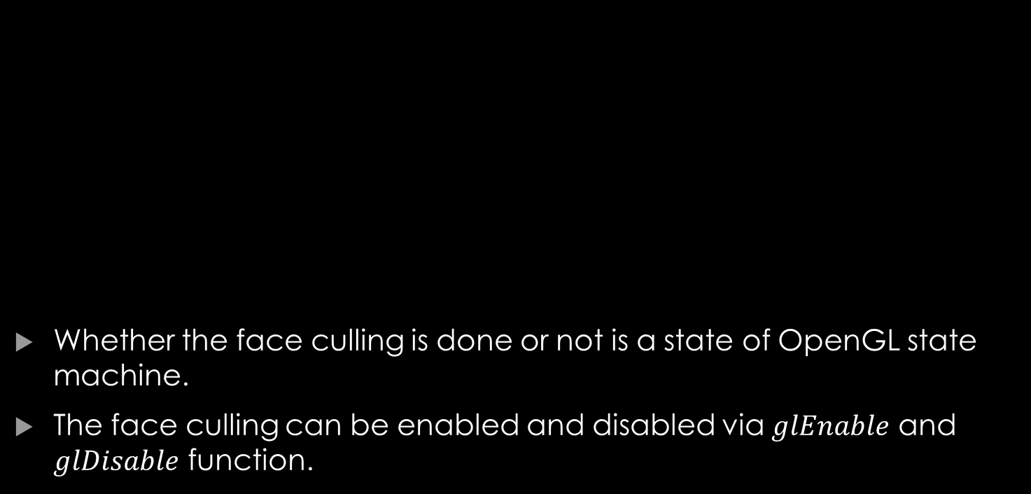
Face Culling
Whether the face culling is done or not is a state of OpenGL state machine.
The face culling can be enabled and disabled via $glEnable$ and $glDisable$ function.
Notes:
Face culling tests whether the fragment is generated from the front face of a primitive or the back face and depending on the OpenGL states, and culls (fails) the fragments accordingly.

Slide 9
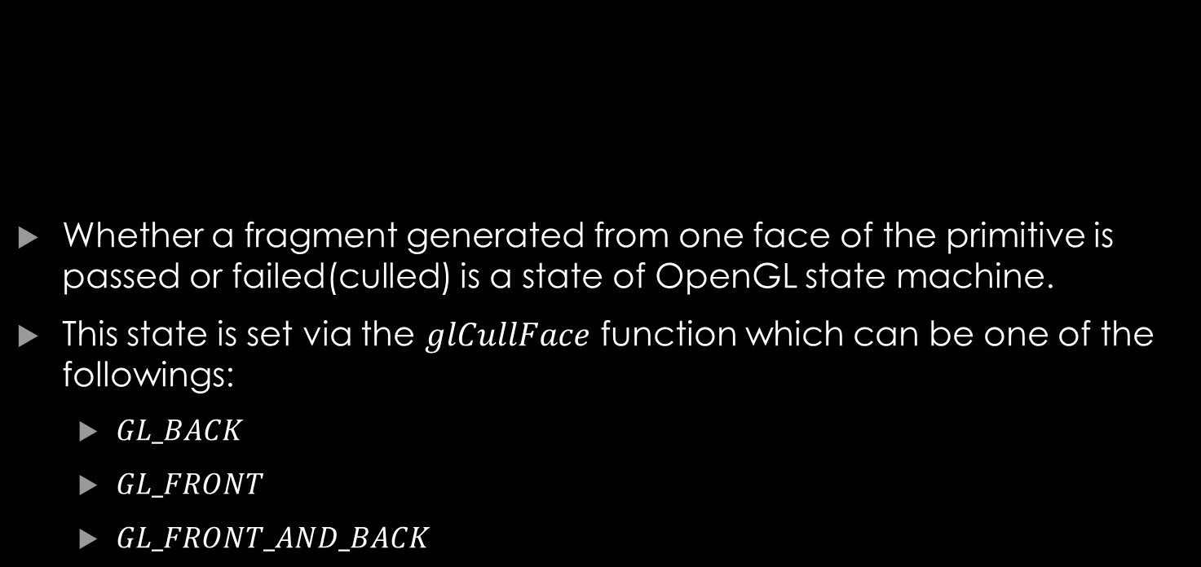
Face Culling
Whether a fragment generated from one face of the primitive is passed or failed(culled) is a state of OpenGL state machine.
This state is set via the $glCullFace$ function which can be one of the followings:
$GL_BACK$
$GL_FRONT$
$GL_FRONT_AND_BACK$
Notes:
The $glCullFace$ function receives a flag(the mode of face culling) as input which determines which face is to be culled. This flag can be one of the followings:
$GL_BACK$ Culls the fragments generated from the back face of a primitive.
$GL_FRONT$ Culls the fragments generated from the front face of a primitive.
$GL_FRONT_AND_BACK$ Culls the fragments generated from the front and back face of a fragments. In this case primitives other than points and line are not drawn.
The default state is $GL_BACK$.

Slide 10
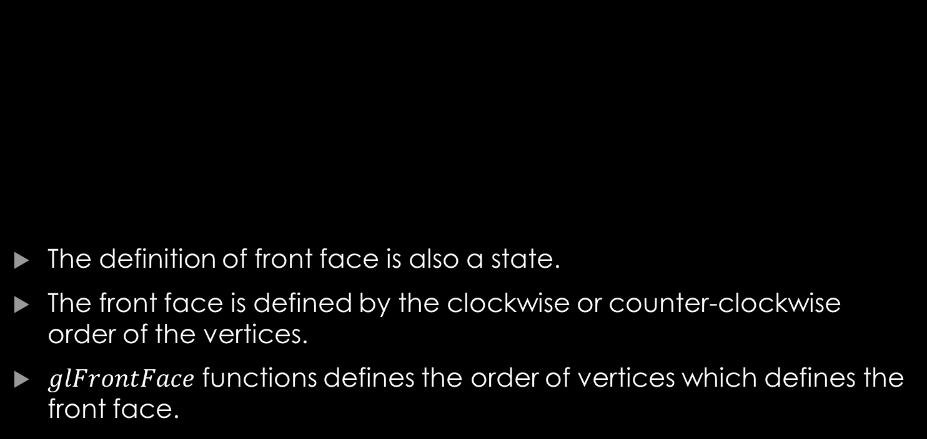
Face Culling
The definition of front face is also a state.
The front face is defined by the clockwise or counter-clockwise order of the vertices.
$glFrontFace$ functions defines the order of vertices which defines the front face.
Notes:
$glFrontFace$ receives the state as input, which can be on of the following:
$GL_CW$ For the clock wise order.
$GL_CCW$ For counter clock wise order.
The default state is $GL_CCW$.

Slide 11
Face Culling
The definition of front face is also a state.
The front face is defined by the clockwise or counter-clockwise order of the vertices.
$glFrontFace$ functions defines the order of vertices which defines the front face.
Notes:
$glFrontFace$ receives the state as input, which can be on of the following:
$GL_CW$ For the clock wise order.
$GL_CCW$ For counter clock wise order.

Slide 12
Program Vertex Shader
A vertex shader receives vertex data, and outputs a 4D vector as the final vertex coordinates.
It is important that the final vertex coordinates pass the clipping test.
The z value of the final vertex coordinates should be set properly to pass the depth test.

Slide 13
Program Fragment Shader
The fragment shader assigns one or more color data to a fragment.
Fragment shader can also modify the depth data of the fragment.
In case of modifying depth data, proper depth should be assigned to the fragment, so that fragments pass the depth test properly.

Slide 14
Vertex Data
Often more than a single set of vertex data is required per vertex (e.g. vertex coordinate, normal vector, texture coordinate).
The are two choices for passing vertex data to OpenGL:
Different buffer for each vertex data.
Single buffer for all the data.
Notes:
These sets of data are going to be sent to vertex shader in tuples for example in the example above each vertex shader will receive a vertex coordinate, a normal vector, and a texture coordinate.

Slide 15
Vertex Data Vertex Array Object
The state of the input is stored in Vertex Array Object(VAO).
VAO holds the buffer description and data description.
The data will be stored in Vertex Buffer Object(VBO).

Slide 16
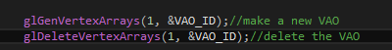
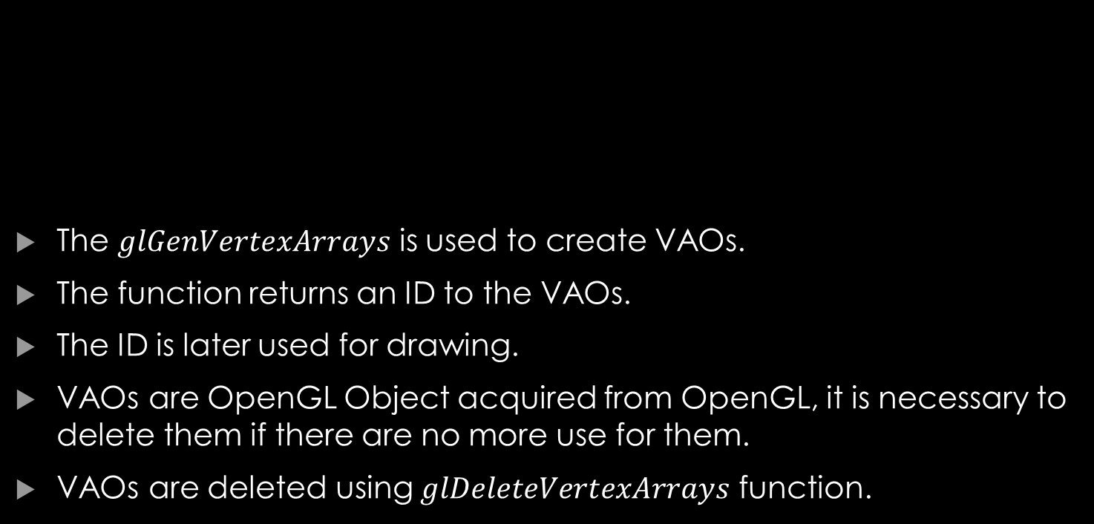
Vertex Data Vertex Array Object
The $glGenVertexArrays$ is used to create VAOs.
The function returns an ID to the VAOs.
The ID is later used for drawing.
VAOs are OpenGL Object acquired from OpenGL, it is necessary to delete them if there are no more use for them.
VAOs are deleted using $glDeleteVertexArrays$ function.
Notes:
$glGenVertexArrays$ receives number of the VAOs to be created and an array in which the ID of the generated arrays will be stored.
$glDeleteVertexArrays$ receives number of the VAAs to be deleted and the array holding the ID of the VAOs to be deleted.

Slide 17
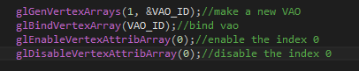
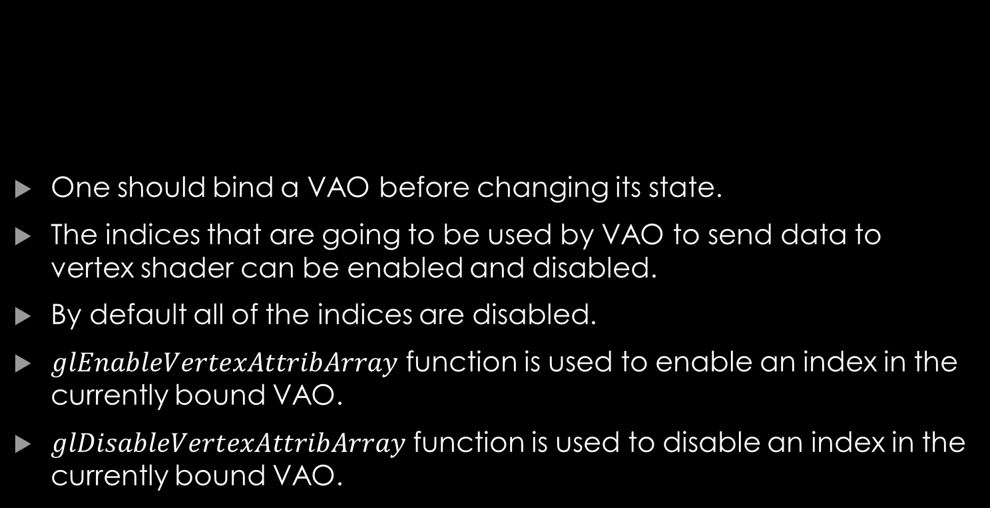
Vertex Data Vertex Array Object
One should bind a VAO before changing its state.
The indices that are going to be used by VAO to send data to vertex shader can be enabled and disabled.
By default all of the indices are disabled.
$glEnableVertexAttribArray$ function is used to enable an index in the currently bound VAO.
$glDisableVertexAttribArray$ function is used to disable an index in the currently bound VAO.
Notes:
Reminder: An Index is a binding point to bind vertex data to vertex attribute (the vertex input variable).
$glEnableVertexAttribArray$ and $glDisableVertexAttribArray$ functions receive index as input and enable/disable that index in the currently bound VAO.
Note that before calling these functions the VAO should be bound.
Binding to 0 will unbind the VAO.

Slide 18
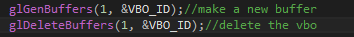
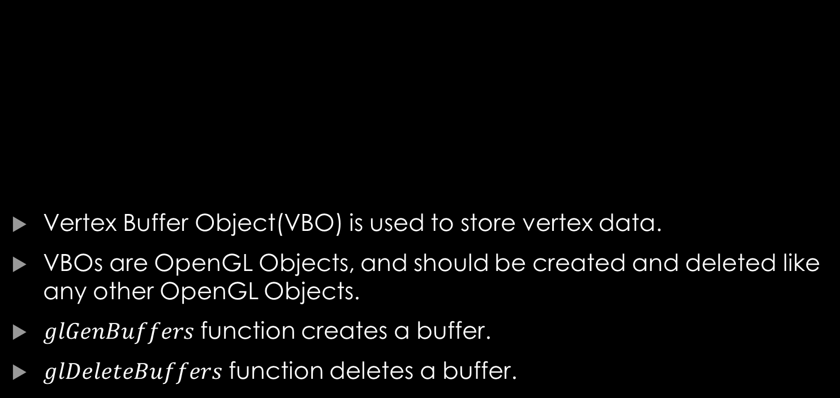
Vertex Data Vertex Buffer Object
Vertex Buffer Object(VBO) is used to store vertex data.
VBOs are OpenGL Objects, and should be created and deleted like any other OpenGL Objects.
$glGenBuffers$ function creates a buffer.
$glDeleteBuffers$ function deletes a buffer.
Notes:
The $glGenBuffers$ and $glDeleteBuffers$ functions receive the number of buffers to be created/deleted and writes the created buffers’ ID in the arrays passed as second argument, or deletes the IDs that are in the array passed to the function.

Slide 19
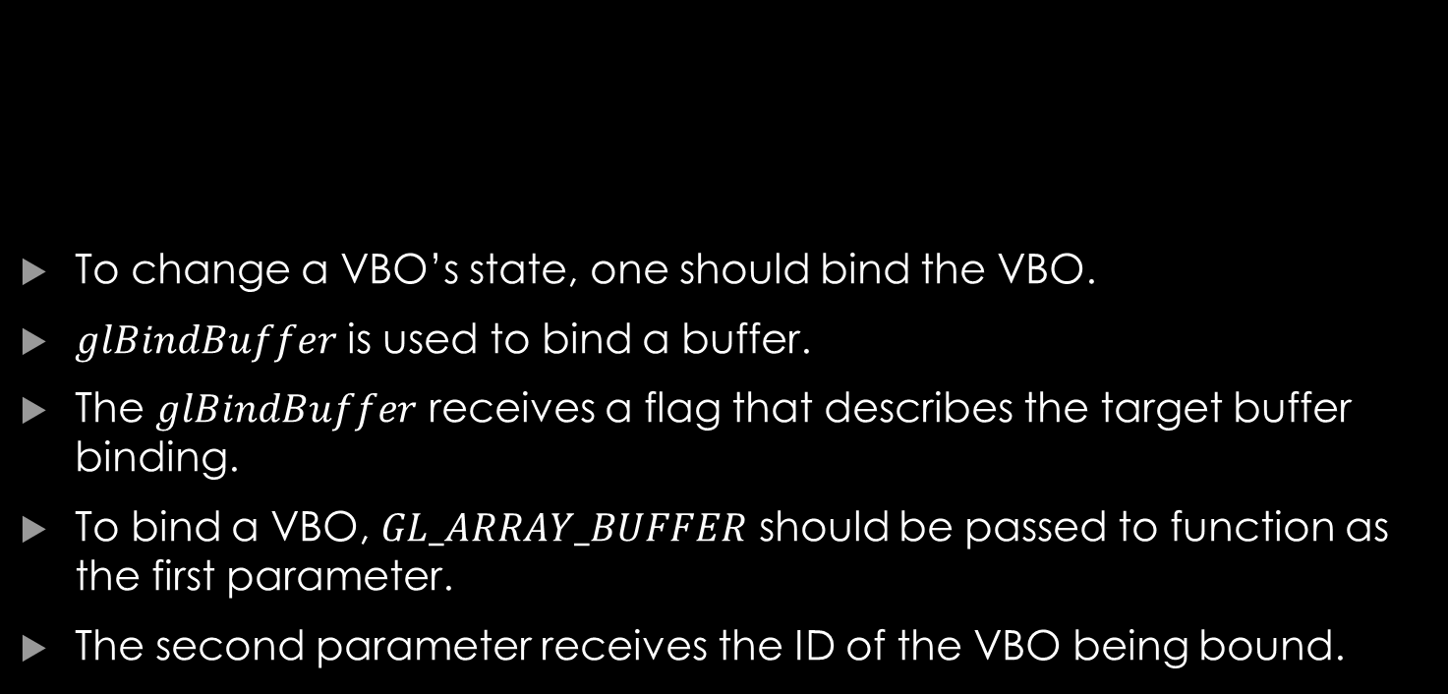
Vertex Data Vertex Buffer Object
To change a VBO’s state, one should bind the VBO.
$glBindBuffer$ is used to bind a buffer.
The $glBindBuffer$ receives a flag that describes the target buffer binding.
To bind a VBO, $GL_ARRAY_BUFFER$ should be passed to function as the first parameter.
The second parameter receives the ID of the VBO being bound.
Notes:
Binding to 0 will unbind the buffer.

Slide 20
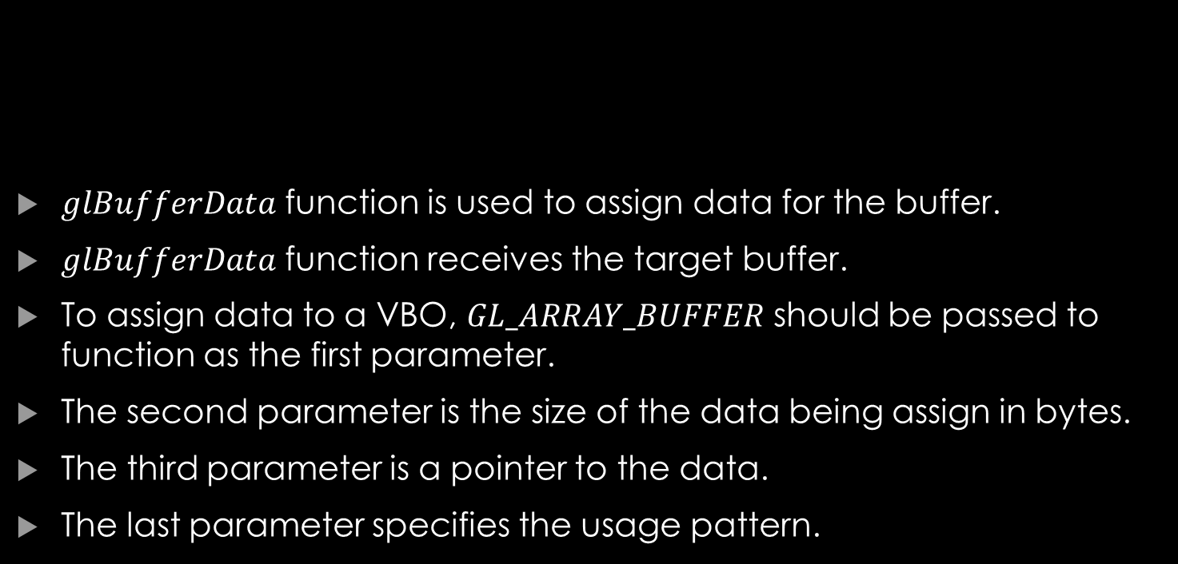
Vertex Data Vertex Buffer Object
$glBufferData$ function is used to assign data for the buffer.
$glBufferData$ function receives the target buffer.
To assign data to a VBO, $GL_ARRAY_BUFFER$ should be passed to function as the first parameter.
The second parameter is the size of the data being assign in bytes.
The third parameter is a pointer to the data.
The last parameter specifies the usage pattern.
Notes:
For our use the last parameter is often set to $GL_STATIC_DRAW$. This means that the data will be modified one by the program, and used several times for drawing.

Slide 21
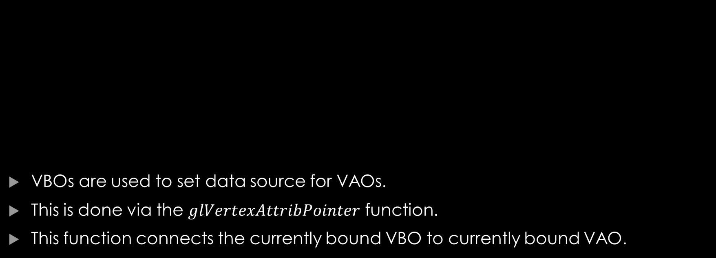
Vertex Data Connecting VBOs to VAO
VBOs are used to set data source for VAOs.
This is done via the $glVertexAttribPointer$ function.
This function connects the currently bound VBO to currently bound VAO.
Notes:
Note that to use this function, both the VAO and the VBO should be bound.
The are other variations of this function (link on the last slide).
The first parameter of the function is the index to which the data will be bound.
The second parameter describes the element count per each data.
The third parameter describes the element type.
The forth parameter is for the normalization of the date.
The fifth parameter is the size of offset in bytes between two consecutive attribute.
The last parameter is the offset size in byte from the start of the data.
After the $glVertexAttribPointer$ changes in VBO does not effect the VAO, so it is possible to delete the VBO.

Slide 22
Putting It All Together
Generate VAO
Bind VAO
Enable Vertex Attribute
Generate VBO
Bind VBO
Assign Data to VBO
Set Vertex Attribute Pointer
Unbind VBO
Delete VBO
Unbind VAO

Slide 23
Vertex Data Individual Buffers for Each Vertex Data
Each data is in a single buffer.
In each data buffer, data of several vertices are contiguous.
The data of a single vertex is fragmented through the memory.
#1 Vertex Coordinate
#2 Vertex Coordinate
#3 Vertex Coordinate
#1 Normal Vector
#2 Normal Vector
#3 Normal Vector
#4 Normal Vector
#1 Texture Coord
#2 Texture Coord
#3 Texture Coord
#4 Texture Coord
#5 Texture Coord
#6 Texture Coord
Notes:
One of the disadvantages of this method is that the data of a single vertex is fragmented through memory and it is not cache friendly.
For this design several VBOs are generated and date is assigned to each VBO accordingly.
Several calls to $glVertexAttribPointer$ are done on each VBO.

Slide 24
Vertex Data Single Buffer
The data of a single vertex is not fragmented and contiguous.
The data of several vertices are contiguous as well.
#1 Vertex Coordinate
#1 Normal Vector
#1 Texture Coord
#2 Vertex Coordinate
#2 Normal Vector
#2 Texture Coord
#3 Vertex Coordinate
#3 Normal Vector
#3 Texture Coord
Notes:
A contiguous set of data is fed to vertex shader at each time, this is cache friendly.
In this design a single VBO is created, and all the data is assigned to this VBO.
Several calls to $glVertexAttribPointer$ is done on this VBO with different offset and stride values.

Slide 25
Frame Buffer
We will use the default frame buffer on this session.
The default frame buffer is mostly described by the pixel format description.
Notes:
We will later discuss on creating frame buffers, and using them instead of default frame buffer.

Slide 26
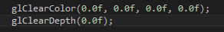
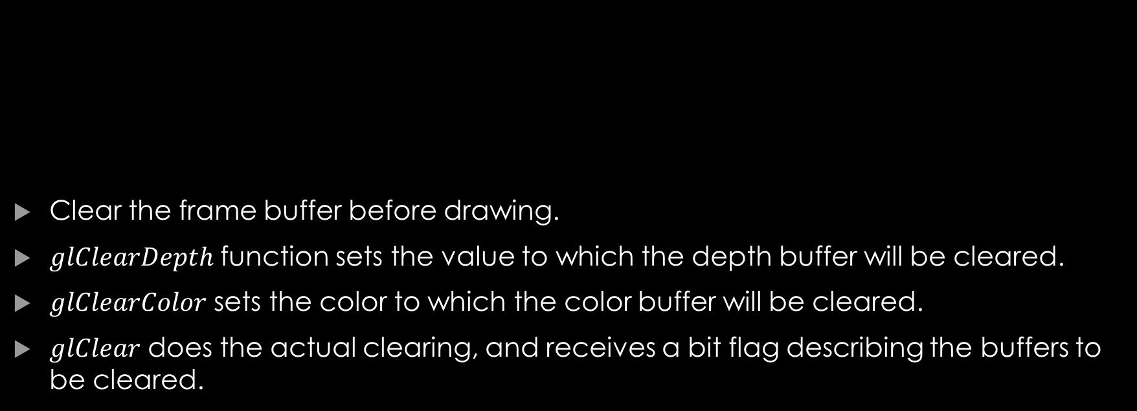
Note
Clear the frame buffer before drawing.
$glClearDepth$ function sets the value to which the depth buffer will be cleared.
$glClearColor$ sets the color to which the color buffer will be cleared.
$glClear$ does the actual clearing, and receives a bit flag describing the buffers to be cleared.
Notes:
The code will clear the color buffer and depth buffer to 0.
$glClear$ accepts any of combinations of the bitwise or of the following bit flags:
$$GL_COLOR_BUFFER_BIT$$
$$GL_DEPTH_BUFFER_BIT$$
$$GL_ACCUM_BUFFER_BIT$$
$$GL_STENCIL_BUFFER_BIT$$

Slide 27
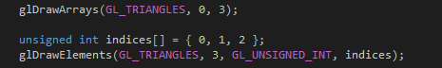
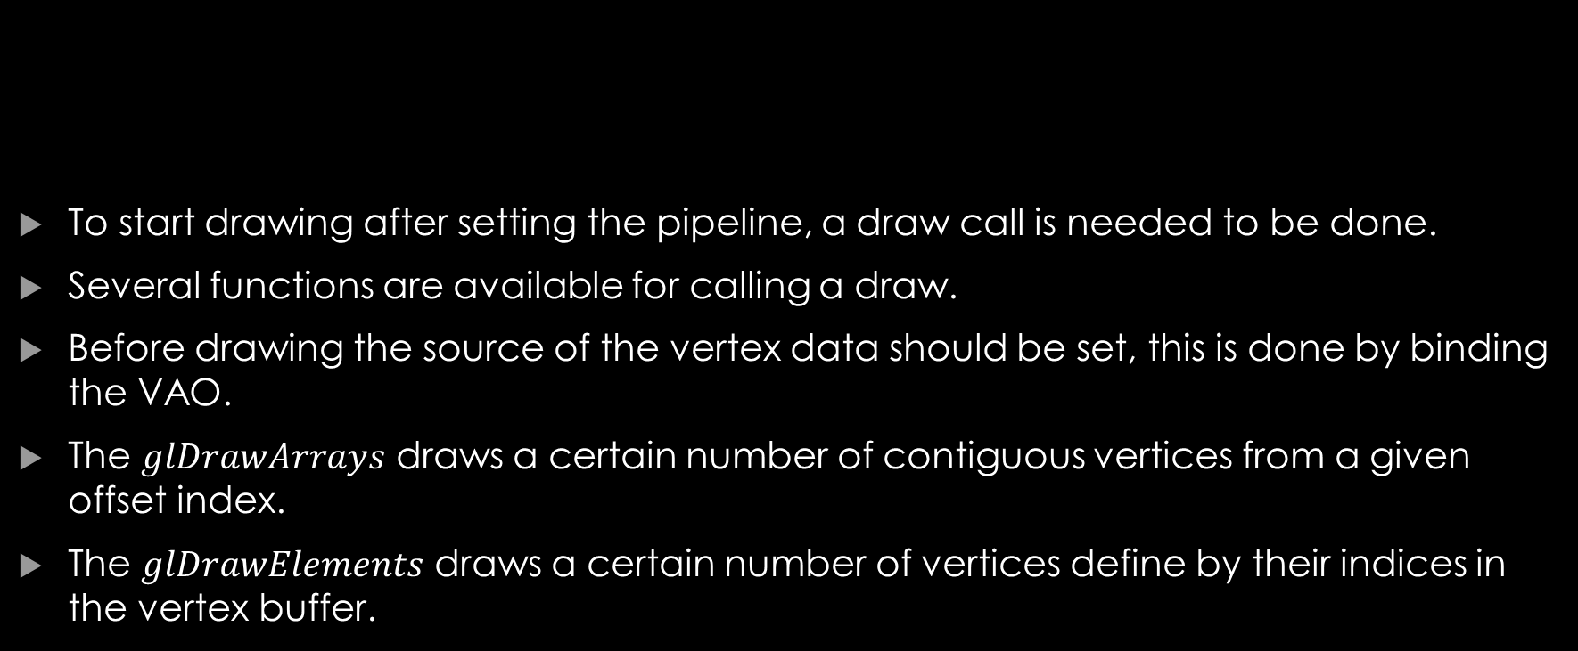
Draw Call
To start drawing after setting the pipeline, a draw call is needed to be done.
Several functions are available for calling a draw.
Before drawing the source of the vertex data should be set, this is done by binding the VAO.
The $glDrawArrays$ draws a certain number of contiguous vertices from a given offset index.
The $glDrawElements$ draws a certain number of vertices define by their indices in the vertex buffer.
Notes:
The both draw calls draw the same thing.
The first parameter of both functions describes the primitive type to be drawn.
The second parameter of $glDrawArrays$ is the offset of the vertex data buffer.
The third parameter of $glDrawArrays$ and the second parameter of $glDrawElements$ are the number of vertices to be drawn.
The forth parameter of $glDrawElements$ is the type of indices in the array, and the last parameter is a pointer to the array of indices.

Slide 28

Your questions

Slide 29
Helpful links
https://www.khronos.org/opengl/wiki/OpenGL_Object (OpenGL Objects)
https://www.khronos.org/opengl/wiki/Vertex_Specification (Vertex Specification)
https://www.khronos.org/registry/OpenGL-Refpages/gl4/html/glBufferData.xhtml (glBufferData)
https://www.khronos.org/opengl/wiki/GLAPI/glVertexAttribPointer (glVertexAttribPointer)
Notes:
https://www.khronos.org/opengl/wiki/OpenGL_Object (OpenGL Objects)
https://www.khronos.org/opengl/wiki/Vertex_Specification (Vertex Specification)
https://www.khronos.org/registry/OpenGL-Refpages/gl4/html/glBufferData.xhtml (glBufferData)
https://www.khronos.org/opengl/wiki/GLAPI/glVertexAttribPointer (glVertexAttribPointer)

